Slide 1


AI Mentor
By Rakib Rana
Bachelor of Software & Electronic Engineering

Slide 2
Project Overview
Fine-tuned models with specialised tutors
Personalised learning modes like flashcards, quizzes and progress tracking
Mobile application (Expo) with authentication and cloud sync
Hosted Backend on EC2 and Website front-end on Netlify (with custom domain)

Slide 3
Current Problems
Some problems are that traditional AI software lacks educational personalisation.
Quality tutoring is expensive and usually very limited in space and also many students need support outside of college hours.

Slide 4
Solutions
Performance tracking and learning paths
24/7 availability
Interactive learning modes to help students greatly.
Student would have a better time if they can learn without constantly asking for support.

Slide 5
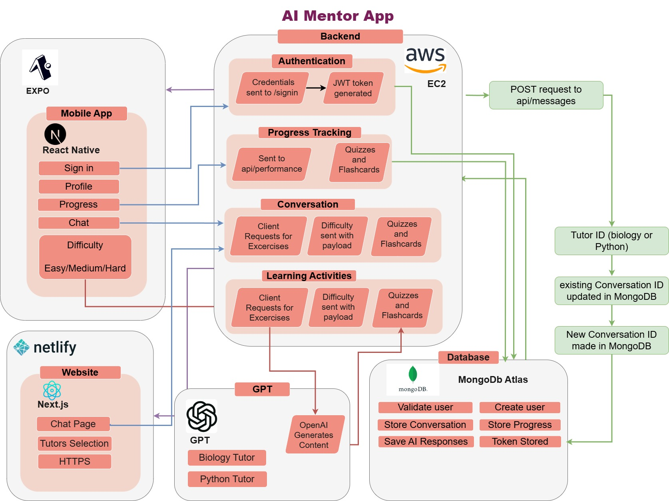
Architecture Diagram

Slide 6
AI Model Training
Fine-tuned models for specific domains such as my biology tutor with topics such as genetics, ecology
Python programming with massive knowledgebase (dumps from Stack Overflow)
Training Method:
Used educational content from trusted sources.
Custom tuning for better responses.
Subject specific cleaned and data uploaded.

Slide 7
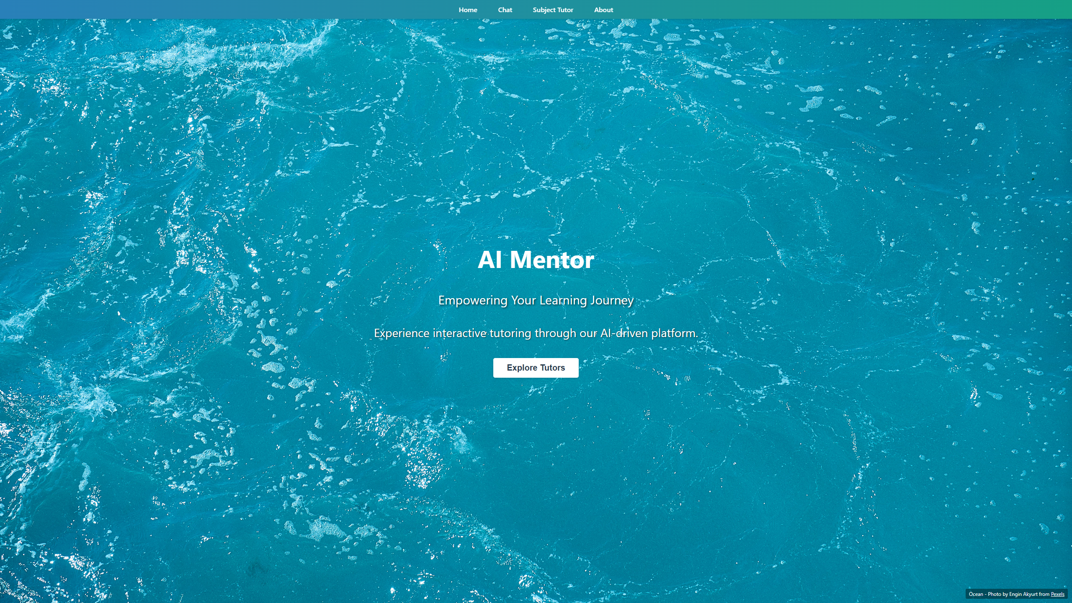
My Website

Slide 8
Features – Conversation
The conversation tab provides an easy way for students to ask questions and receive detailed explanations.
Natural dialogue with subject specific tutors such as my biology and python tutors' options.
Contextual explanations adapted to user understanding

Slide 9
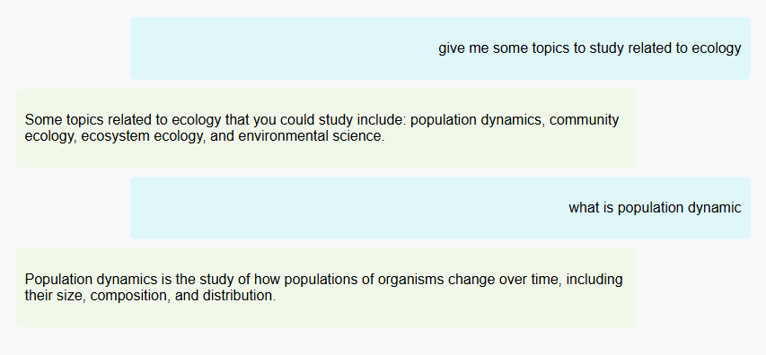
Conversation - Example

Slide 10
Mobile Expo App
Includes user login and authentication
Difficulty setting for a more tailored experience
Conversation sync with desktop app
Individual topic progression
In depth explanation for each answer in quizzes

Slide 11
Learning Tools
Our learning tools automatically adjust difficulty based on students' preference from easy, normal to hard mode. This is brilliant for creating a custom-made learning experience.
Interactive flashcards that adjust to performance
AI-generated quizzes with personalized feedback
Progress tracking across subjects and topics

Slide 12
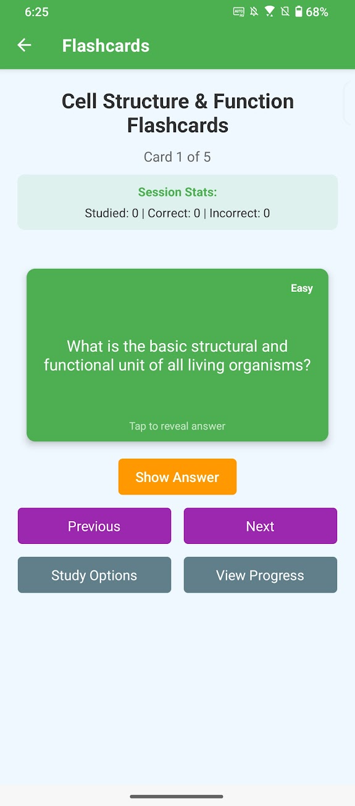
Flashcards - Showcase

Slide 13
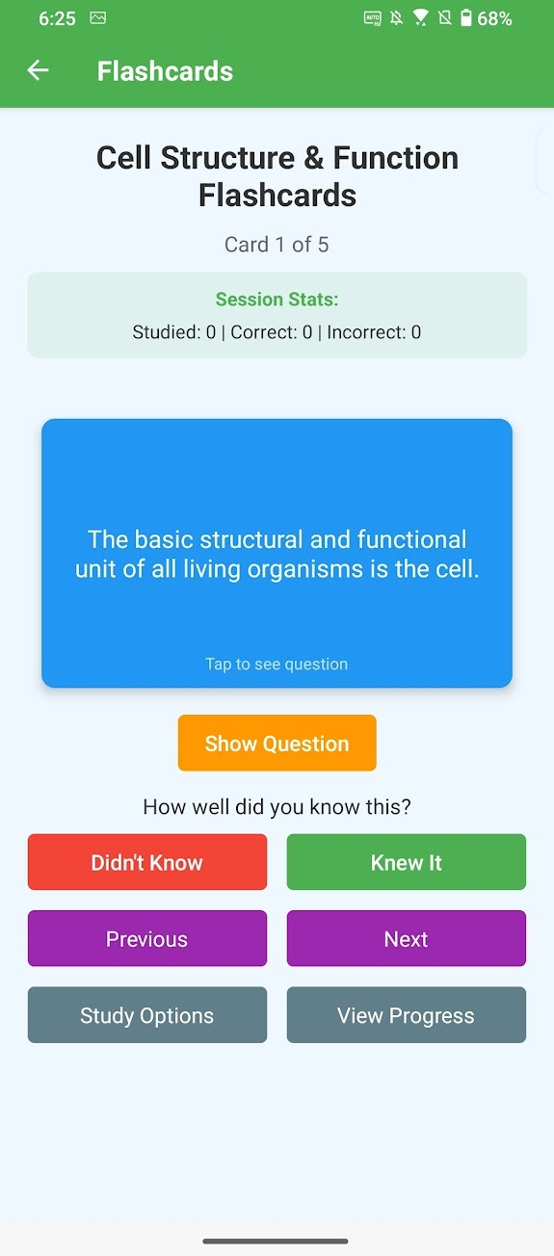
Flashcards - Showcase

Slide 14
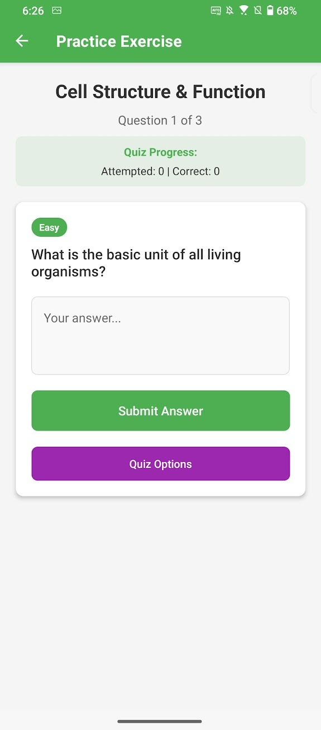
quiz - Showcase

Slide 15
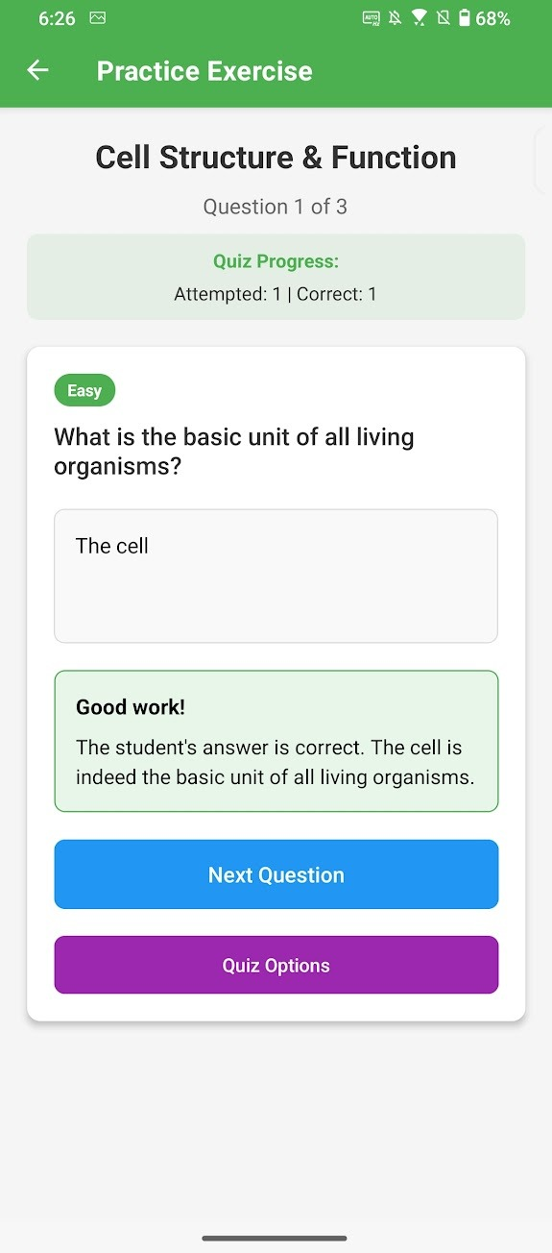
Quiz - Showcase

Slide 16
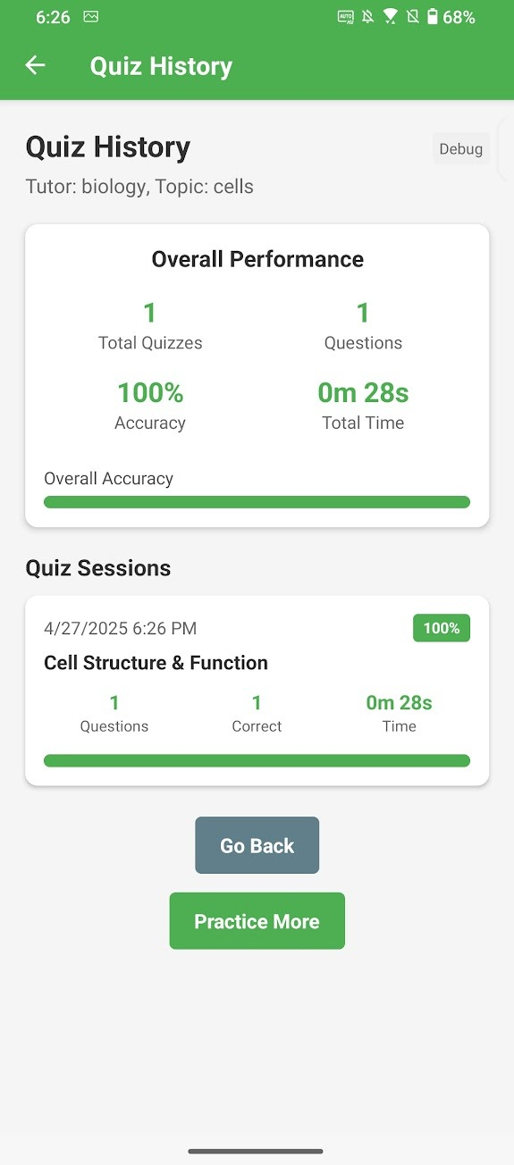
Progression - Showcase

Slide 17
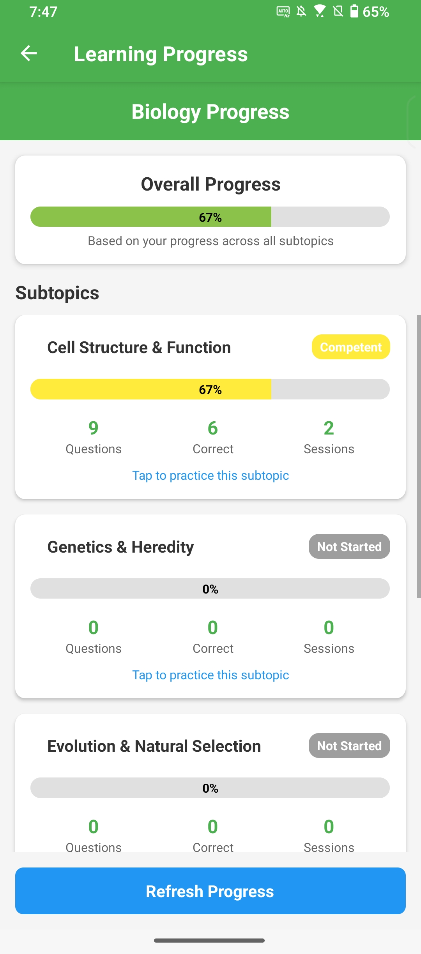
Overall
Progression - Showcase

Slide 18
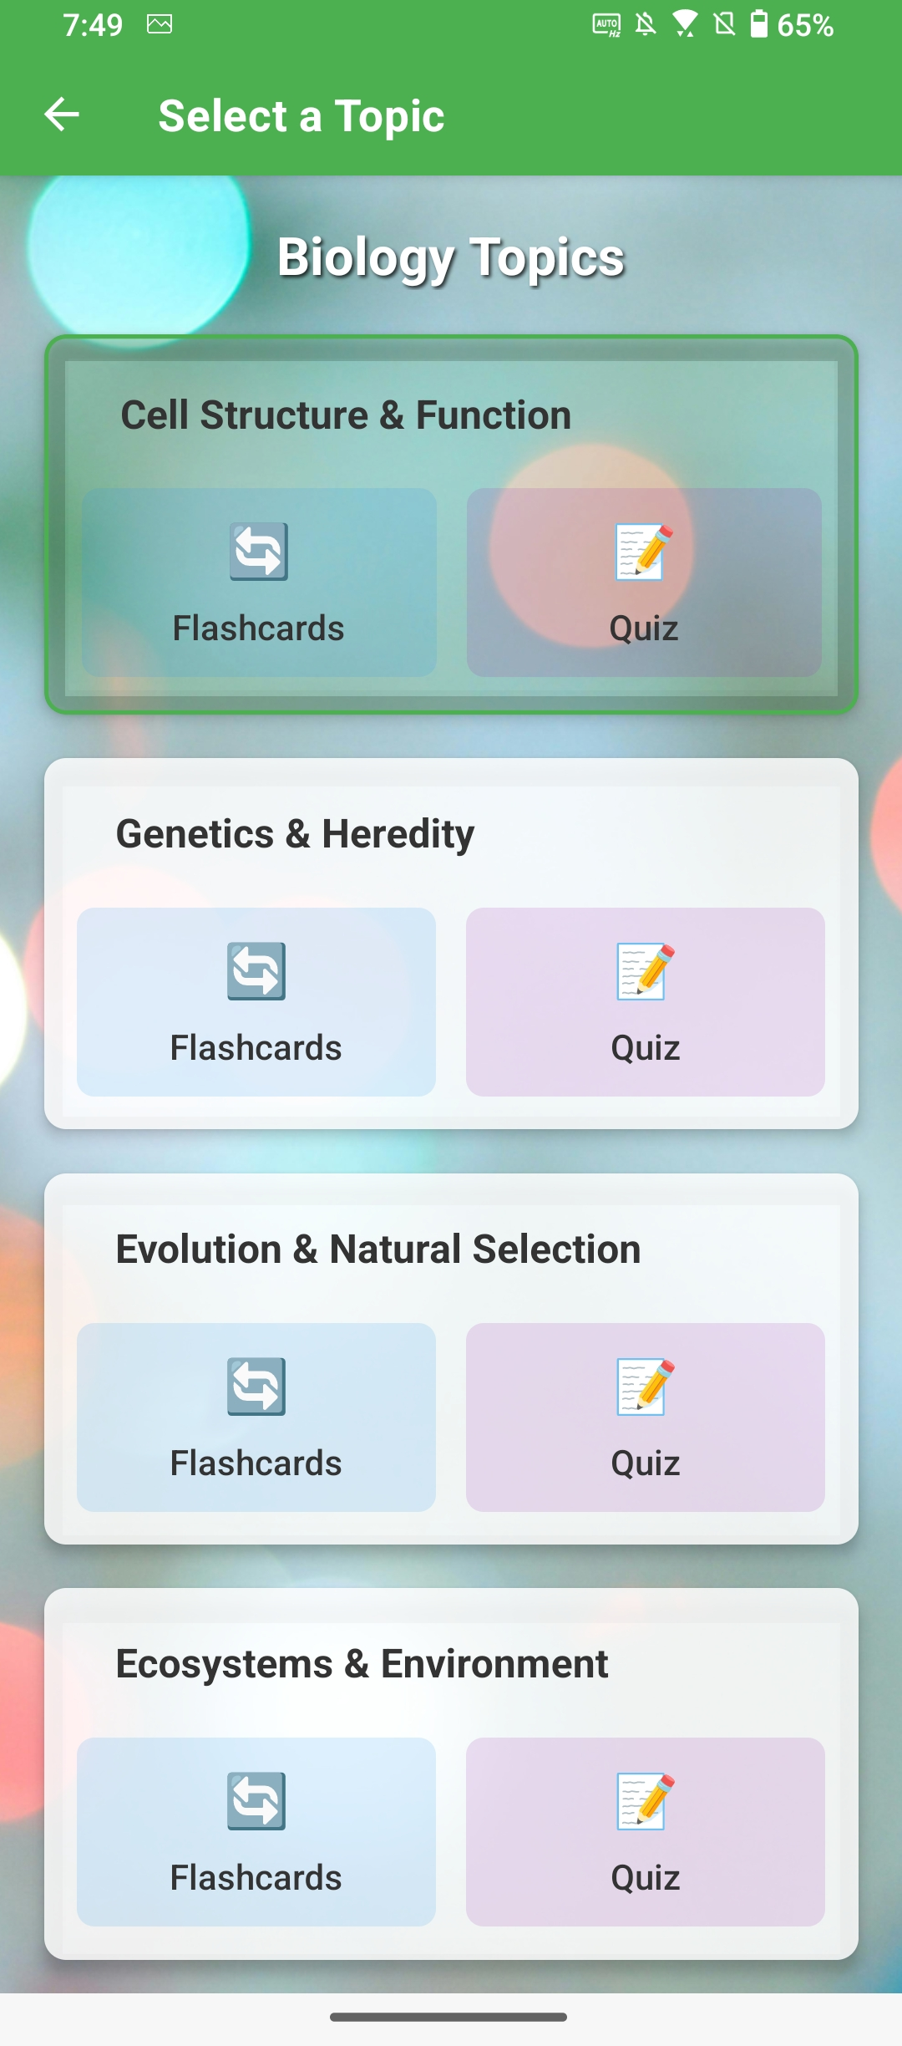
Overall
Progression - Showcase

Slide 19
Demo
https://youtu.be/Mo_94nMYWs0

Slide 20
Conclusion
I believe this AI Mentor is accessible and capable enough to keep users engaged and excited to learn more on a daily basis. The flashcard and quiz system is a responsive and a seamless experience for improving your own knowledge base. All put together with an overall progress system.
I hope in the future I am able to add more features to demonstrate the power of fine-tune models and AI.

